Slide 1
CARE Values
Presented by Scarlett Walsh :>

Slide 2
At Woodley, we care
At Woodley Primary School, we follow certain rules known as CARE. CARE is a special list of rules we are expected to follow inside and outside of school. These values will help us become better people in the future and they shape who we are.

Slide 3
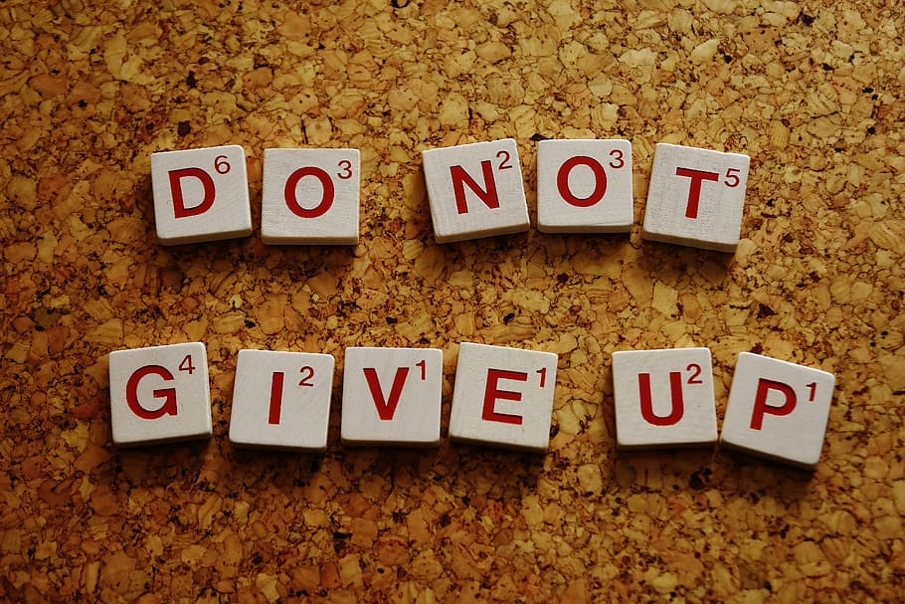
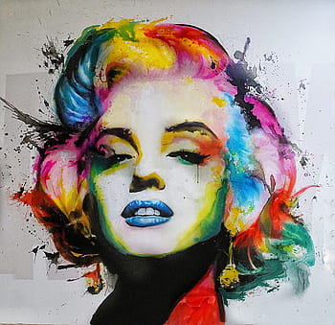
What does C stand for?
In CARE, C stands for Confident and Creative! On the confident side, confidence is key to Woodley Primary, whether it’s making a piece of writing, or reading a new and difficult book. Confidence shows that you are willing to do anything without giving up. On the creative side, creativity is an amazing thing to be experienced in, like making art, and cooking food. Creativity means that you are coming up with your own ideas, and making up a fantasy inside your head, like imagination.

Slide 4
What does A stand for?
In CARE, A stands for Aim High, and Be Ambitious! Aim high means to make an amazing piece of work, and if it doesn’t seem right, keep making improvements to make it look astounding, and put your best effort into it. Be ambitious means to try something new, and if you don’t succeed, try and try again. Find something you want to do and don’t let anything get in the way.

Slide 5
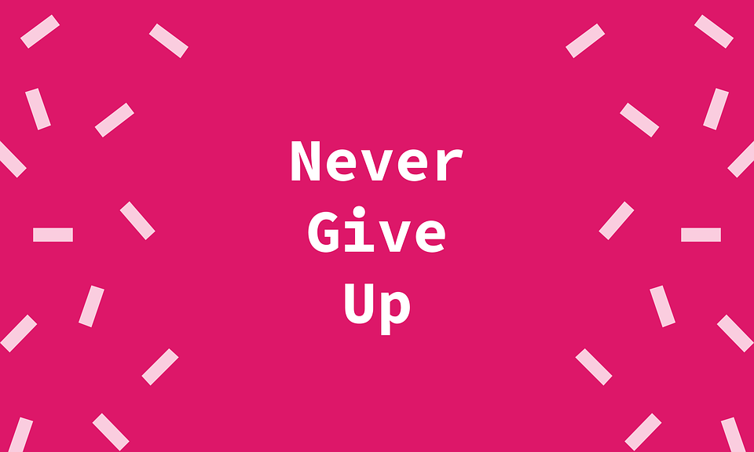
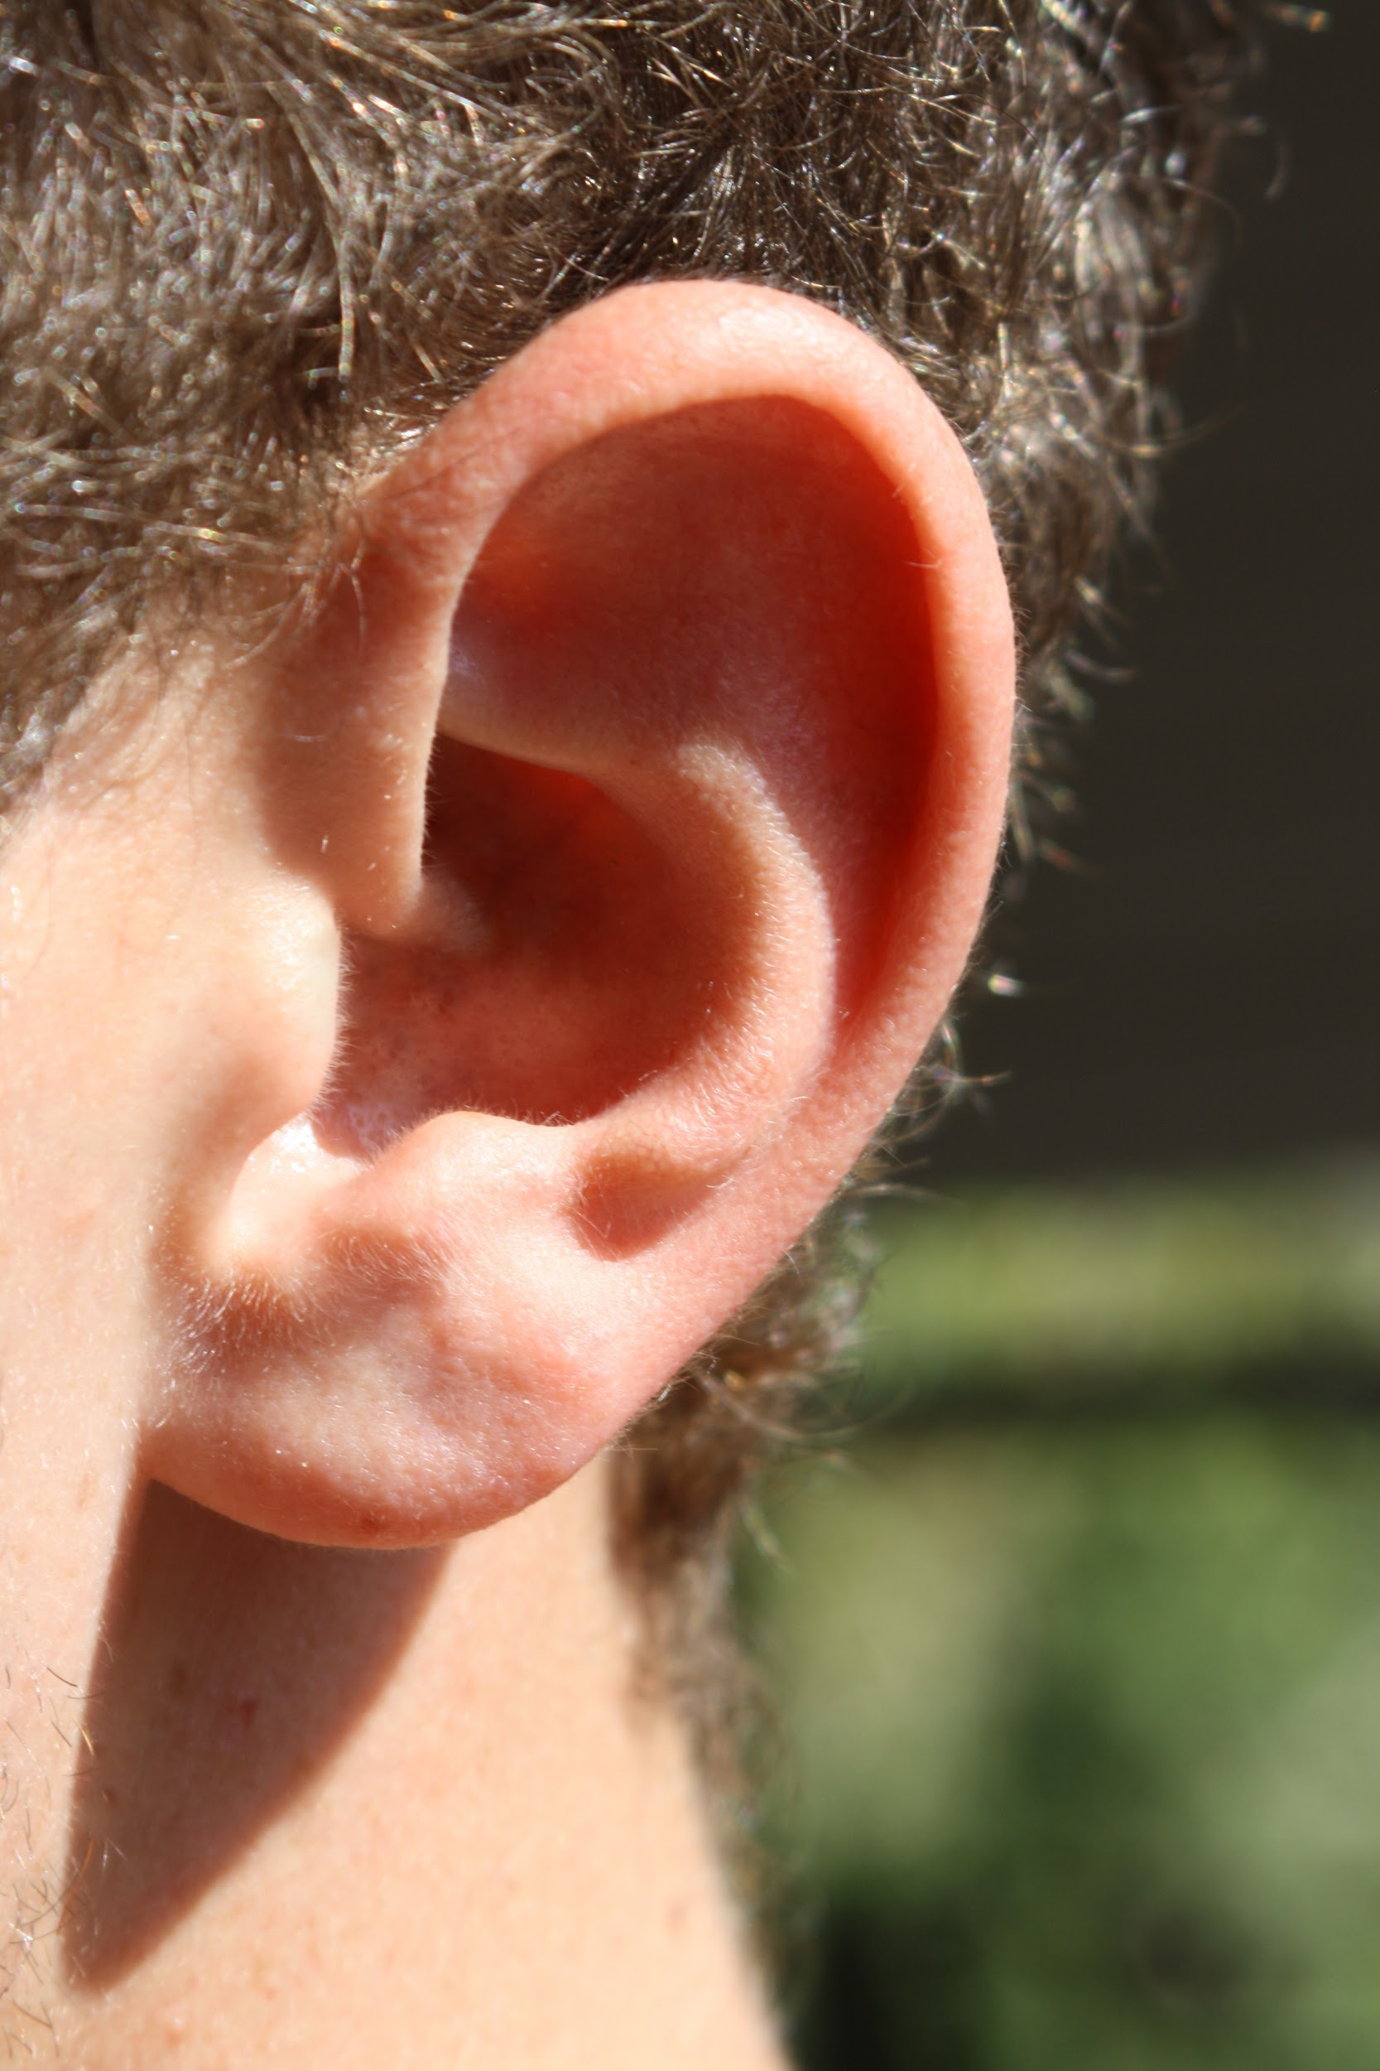
What does R stand for?
In CARE, R stands for Resilience, Responsibility, and Respect! Resilience means to persevere, also meaning never to give up when your first attempt goes wrong. Responsibility means to act more like an adult, or more mature, or to make the right decisions by yourself. Last but not least, respect means to treat people how you want to be treated, listen to them, and if you respect someone, another person will pay you back in respect.

Slide 6
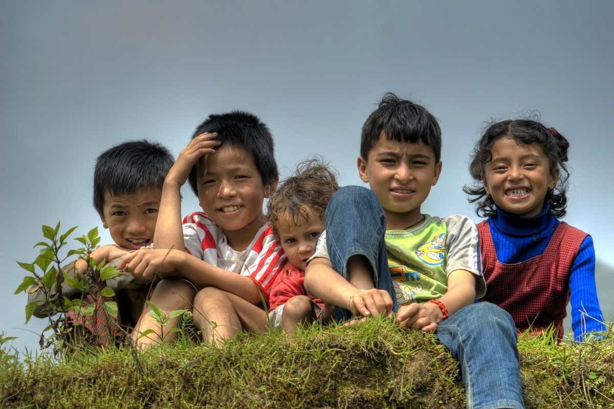
What does E stand for?
Finally, in CARE E stands for Everyone Matters! This means that if you have a certain believe, different opinions, have a different skin colour, or a different gender to another person, you matter to everyone, and no matter what anybody says, you shine bright like a diamond✨💎! You are amazing just the way you are, and remember, treat people with respect!

Slide 7
End Title
Thank you so much for reading my Powerpoint, and I hope you understand CARE more than you did before. Have a great day/night! :>

